Slide 1
CODEC
By: Sindhuja Kadira

Slide 2
Agenda
What is Codec?
Why do we need Codec?
Types of Codec
Compression Techniques
Classification of Codec
H.264 Codec
Structure of H.264 Encoder
Structure of H.264 Decoder
Why H.265 emerged?
Structure of H.265 Encoder and Decoder
Difference between H.264 and H.265
Conclusion
Reference
Nov 27,2023

Slide 3




What is Codec?
A "codec" is a software or hardware tool that is used to compress and decompress digital media, such as audio and video.
Nov 27,2023

Slide 4
Why do we need Codec?
Takes less memory.
Enable efficient data transmission.
The primary purpose of a codec is to reduce the file size of digital media for storage, transmission, or streaming, while maintaining an acceptable level of quality.
Nov 27,2023

Slide 5
Types of codec
Lossless codec:
>>Lossless codecs have a data compression algorithm that enables the compression and decompression of files without loss of quality.
>>Removes redundant data.
>>This is good for preserving the original quality of the file.
>>Lossless codecs are a good fit for film, video and photo editing.
Lossy codec:
>>Lossy compression also has different compression techniques that are defined as intraframe and interframe.
Nov 27,2023

Slide 6
Compression Techniques
Intra-frame Compression
>>Compression in a frame.
>>exploiting spatial redundancies.
>>Keyframes, used as reference points.
Inter-frame Compression
>>Compression among frames.
>>exploiting temporal redundancies by focusing on changes between frames.
>>P-Frames are predicted from previous frames.
>>B-Frames use both past and future frames for prediction.
Nov 27,2023

Slide 7
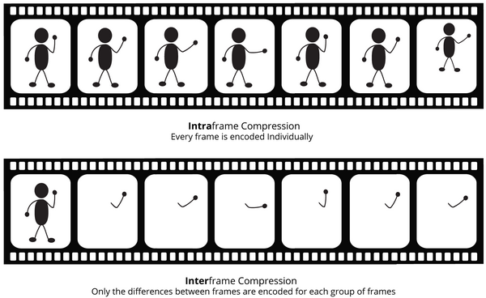
Compression Techniques
Nov 27,2023

Slide 8
Classification of Codec
Classification of Codec
Text Codec
Speech Codec
Audio Codec
Video Codec
Image Codec
Nov 27,2023

Slide 9
Classification of Codec
Text codec:
>>A text codec is a function that transform into or out of another kind of representation, mostly the huma-readable representation is "decoded" text.
>>"Encoders" will turn the text into something less readable.
>>"Decoders" try to revert those effect as good as possible.
>>example: ROT-13, Base64.
ROT-13
ABCDEF------- ------->NOPQRS------- ------->ABCDEF
encoder
decoder
Nov 27,2023

Slide 10

Classification of Codec
Image codec
>>Lossy Image codecs achieve compression by discarding some image information.
Examples: JPEG.
>>Lossless Image Codecs retain all original image information.
Examples: PNG.
JPEG
PNG
Nov 27,2023

Slide 11
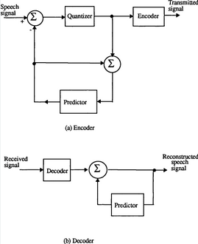
Classification of Codec
Speech codec:
>>Lossless compression methods start with a digital representation of the source and use encoding techniques that allow the source to be represented with fewer bits while allowing the original source digital representation to be reconstructed exactly by the decoder.

Slide 12
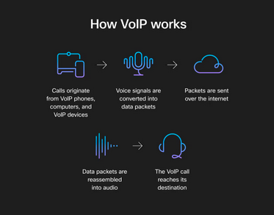
Classification of Codec
>>Lossy compression methods relax the constraint of an exact reproduction and allow some distortion in the reconstructed source.
Example: VoIP.

Slide 13
Classification of Codec
Audio codec:
>>audio codecs are programs that reduce this file size and can be split into two categories- "lossy" and "lossless".
>>A "lossy" codec achieve compression by removing the non-essential information.
Example: MP3, OGG Vorbis, AAC.
>>A "lossless" codec compress audio without loss of quality.
Example: FLAC.
Nov 27,2023

Slide 14
Video codec:
>>Lossless Video Codecs aim to retain all original information during compression.
Examples: ProRes and FFV1.
>>Lossy Video Codecs discard some information to achieve compression.
Examples: H.264/AVC, H.265/HEVC.
Classification of Codec
Nov 27,2023

Slide 15
H.264
>>H.264, also known as AVC, is a widely used video compression.
>>It is designed to efficiently compress and transmit video data while maintaining high video quality.
>>supports a wide range of resolutions, including standard definition(SD), high definition(HD) and even 4k.
>>H.264 is commonly used for a wide range of applications, including video streaming, video conferencing, broadcasting, Blu-ray discs, digital television, and more.
Nov 27,2023

Slide 16
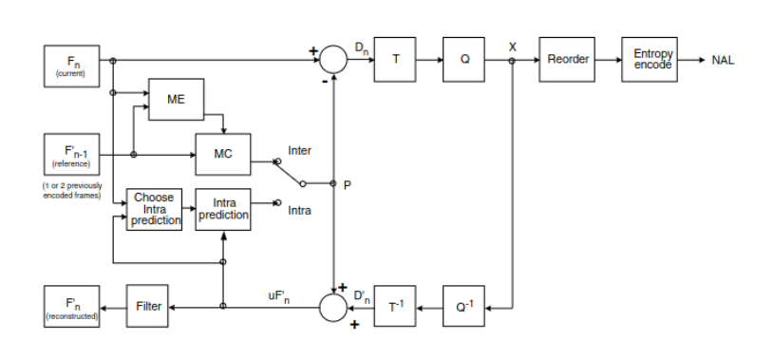
Structure of H.264 Encoder
Nov 27,2023

Slide 17
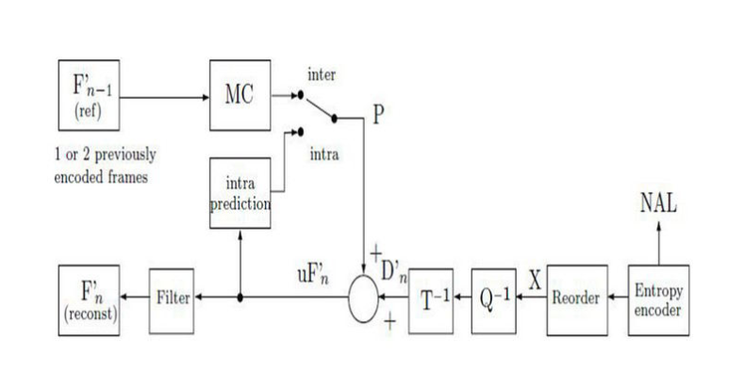
Structure of H.264 Decoder
Nov 27,2023

Slide 18
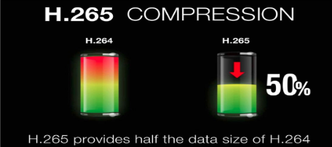
Why H.265 emerged?
H.265 is also known HEVC (High Efficiency Video Coding). HEVC is a new Compression standard that offers 25-50% better data compression than H.264/AVC while maintaining the same level of video quality .
Nov 27,2023

Slide 19
Why do we need H.265?
Because H.265 compresses your data so much more efficiently, using it as your video compression tool will drop your bandwidth and storage requirements by roughly 50%. The table below compares the recommended bandwidth for H.264 vs. H.265 encoding.
Resolution | Minimum Upload Speed of H.264 | Minimum Upload Speed of H.265
480p | 1.5mbps | 0.75mbps
720p | 3mbps | 1.5mbps
180p | 6mbps | 3mbps
4k | 32mbps | 15mbps
Nov 27,2023

Slide 20
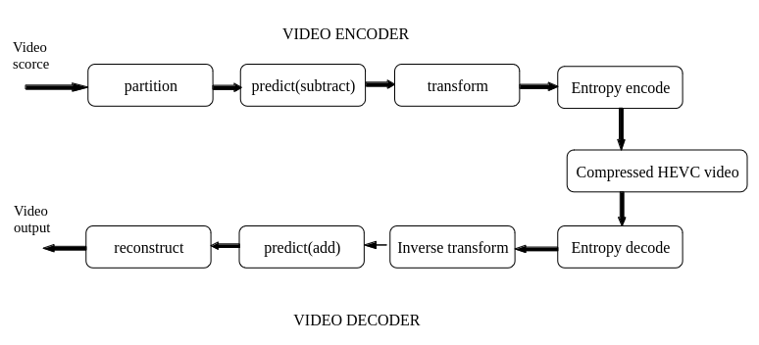
Structure of HEVC Encoder and Decoder
Nov 27,2023

Slide 21
Difference between H.264 and H.265
The main difference between H.264 and H.265 is how each processes information and the resulting video file size and bandwidth consumption used with each standard.
H.264 processes frames of video using macroblocks, while H.265 processes information using coding tree units (CTUs).
CTUs process information more efficiently, which results in a smaller file size and less bandwidth used for your streamed video.
Nov 27,2023

Slide 22

Difference between H.264 and H.265
Nov 27,2023

Slide 23
CONCLUSION
Live streaming in H.265 will provide you with a higher-quality image while using less bandwidth. At the same time, You can create high-quality streams with H.264 — just make sure you have the correct network speed to do so (5-10mbps upload).H.264 needs more bandwidth, Because H.265 compresses your data so much more efficiently, using it as your video compression tool will drop your bandwidth and storage requirements by roughly 50%.
Nov 27,2023

Slide 24
Nov 27,2023

